Slide 1




Slide 2







OpenVision is the future and should be in yours!
Our Intelligent solutions make OpenVision the only Network (Linear or Cable) that can expand a known brand like the Maybach Music Group.
Within these pages you will find solutions to help you grow a network and take control of your diverse talents & ventures. We will enable you to increase your Global Market & ensure Sponsorship Commitment & Growth, all at no cost to your current fans!
Let us show you how owning an OpenVision International TV Network can expand your reach & maximize monetization on all of your bands, from Movies & TV to Music, Merchandise & Philanthropy!
…all this at the cost of the promotion of one record…you do the math!
-Open Your Vision with OpenVision
We are honored to introduce to the world the latest form of broadcast technology.
Taking pride in elevating viewer’s expectations, while giving our clients various ways to monetize on this assiduous technological experience.
Our Intricate Network capabilities are limitless as we offer you a practical solution to the world of complex media.
OpenVision International Cable is the only cable provider being viewed in every country in the world, 24hrs a day with 100% Free basic service.
Desktop, iPad, Smart Phone and Tablet apps help us bring viewers an “Infinite Lean Back” experience by freeing them from the couch and allowing them to watch completely at their leisure!
-Yes! Real Cable on your Smart Phone, Tablet or Computer!

Slide 3

Open Vision is a complete Broadcast Communications Company that has created the worlds first Virtual Mainstream International Cable Network.
Thru our Broadband Technology we deliver Scheduled, On Demand, Live stream and Pay-per-View Programming.
What we have created is the most Intelligent Broadcast Technology to date.
With an OpenVision Network you can push traditional viewing, steroid marketing, purchase power and global branding to levels previously unheard of.
How do we work?
We are an application, NOT a .com, a WEBSITE, WEB TV or USTREAM, but a real cable experience. We simply connect thru the internet to allow viewing on the devices the world spends the majority of their time on.
Picture it this way, Comcast connects thru digital boxes, Dish Network connects thru satellite dish and OpenVision simply connects thru your internet on any broadband or wifi device.
Once clicking the OpenVision Application you are in cyberspace and attached to the network with the ability to flip thru channels similar to traditional cable or linear television.
Did you know, after 2013 all televisions will be built with wifi? Meanwhile, connect any mobile device or computer to your television with a hdmi cord to serve as your cable box.
It’s that simple!

Slide 4
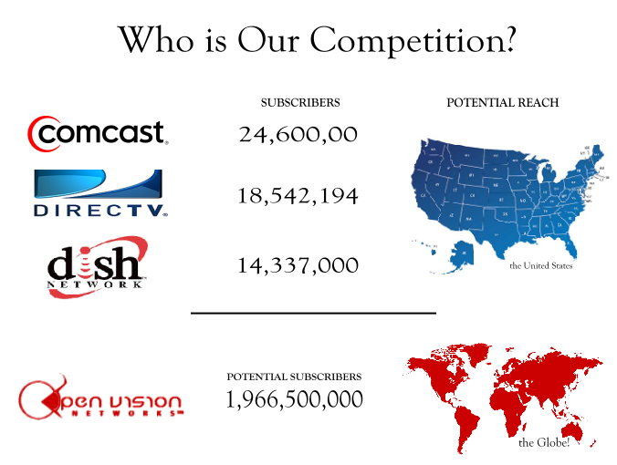


We are the ONLY complete cable network that can reach 1,966,500,000 people simultaneously.
We are the ONLY complete global network that can provide you the same channel on any device worldwide.
We are the ONLY complete cable network that broadcasts via Computer, Smart Phone, iPad and Tablet applications.
We are the ONLY complete cable network where basic cable will always be FREE and there’s no equipment to buy.
There is no competition!
The goal of any Network, Content Provider or Show is to increase viewer ship and entice prime sponsors. OpenVision surpasses the competition and goes several steps further.
With the current rating system, every household is not equipped with a rating box; therefore, viewership is merely an estimate. With OpenVision, we know the exact demographic of who is watching and how long they watched, for every viewer and every channel worldwide!
-No More guessing games!

Slide 5



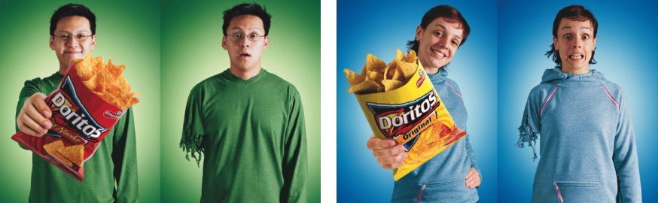
The purpose of marketing is to generate revenue, increase market share, drive preference to purchase and build brand awareness. Adopting an integrated marketing strategy is a great way to do this effectively and should be the first step.
Marketing has moved far beyond traditional and includes all sorts of interactive, consumer driven, social marketing and communication messages across all available media channels. OpenVision Network envelopes and supersedes the world’s technology driven marketing needs.
Extreme Integrated Marketing includes various tools of advertising, promotion, commercial marketing, direct marketing, sponsorship, event marketing, social fundraising and banner advertising.
Consumers are bombarded with thousands of messages from thousands of different advertisers daily. Our technology allows us to extract to the minute Logistics allowing us to filter out messages that don’t appeal to a viewers particular need or interest.
Men don’t have a need for feminine products therefore sending feminine ads to men is pointless.
Our data extraction can tell the viewers favorite color or interests, male or female and more!
Studies show, that consumers are more apt to purchase while watching something that is visually appealing and evoke certain emotions. Targeting consumers with color is one way to create such an atmosphere.
Two people on opposite sides of the earth can be watching the same channel and receiving the same commercial with different effects. According to the data we’ve collected, we know that Consumer A’s favorite color is green therefore, the ad on the left would fit best.
Yes, we can do that!

Slide 6

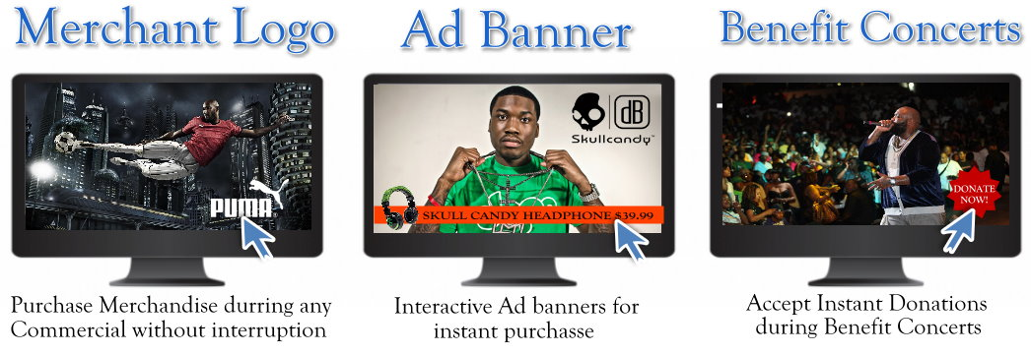

Why rely on viewers to go to a website, in the store or call to make a purchase. We give you and your sponsor’s options far beyond what traditional television can give.
Point-2-Purchase Power allows purchasing without interruption of the commercial, program or live event. Simply click a logo and a menu will allow you to purchase any merchandise in that merchants account. Instantly sell music and more!
Why we are different than a Website!
Imagine your website as a stand-alone entity an island if you will. No one knows you’re there unless you’re spending money and time to drive visitors to it.
The issue with this is you usually only end up with current fans or product users who are looking for you.
With OpenVision, since we are NOT a .com, you are no longer a stand-alone entity but in a world of other networks. You now have neighbors and those neighbors have neighbors all across the globe.
We are all creatures of habit, so much so that most of us change the channel on commercials and often stumble upon something of interest. Your neighbors viewer may find your channel, enjoy your content and take up residence from anywhere in the world.
-A website can’t do that!

Slide 7




Improving & Strengthening digital ROI for brands and publishers
With 24/7 we are strengthening advertising opportunities for marketers across the globe.
24/7 has partnered with Microsoft Advertising to provide extraordinary experiences for consumers and effective solutions for digital marketing partners, creating new value in the market place.
The agreement consists of four main components that will help strengthen advertising technology stacks and expand opportunities for the marketer and publisher clients of both WPP and Microsoft Advertising.
24/7 Media, Inc. is a leader in digital marketing technology, serving advertisers, agencies and digital publishers worldwide. The 24/7 technology platform spans every digital channel, providing users with unprecedented control and consolidated data analysis. This technology powers two specialized business units: Real Media Group helps marketing organizations engage their audiences with superior precision, transparency and return on investment. The group also helps digital publishers monetize their properties and manage advertising operations more effectively. Media Innovation Group provides advertisers and agencies with strategic consulting and implementation services that deliver competitive advantage in fields being transformed by technology.
Microsoft Advertising provides advertisers and publishers with media, tools and services to help drive deep and profitable engagement with their audiences. This includes a media network that reaches hundreds of millions of consumers around the world; global technology platforms and tools that enable easy planning and management of campaigns and content; and services that help untangle the complexities of digital media to get more value from marketing and content investments. Microsoft Advertising makes buying and selling media simple, smart and cost-effective across media and devices in the Microsoft network of properties and beyond.

Slide 8


CPM –Cost Per Mille or cost per 1000 impressions
*assumptions based on below standard CPM and for example purposes only
CPM | Viewers | Runtime Hours | 30 Sec Commercial Spot/hour | Total Spots | Rev Per Day | Rev Per Week | Rev Per Year
$5.00 | 1000 | 6 | 8 | 48 | $240 | $1,680 | $87,600
$5.00 | 10000 | 6 | 8 | 48 | $2,400 | $16,800 | $876,000
$5.00 | 30000 | 6 | 8 | 48 | $7,200 | $50,400 | $2,628,000
$5.00 | 50000 | 6 | 8 | 48 | $12,000 | $84,000 | $4,380,000
$5.00 | 100000 | 6 | 8 | 48 | $24,000 | $168,000 | $8,760,000
$5.00 | 500000 | 6 | 8 | 48 | $120,000 | $840,000 | $43,800,000
$5.00 | 1000000 | 6 | 8 | 48 | $240,000 | $1,680,000 | $87,600,000
$5.00 | 1500000 | 6 | 8 | 48 | $360,000 | $2,520,000 | $131,400,000
$5.00 | 2000000 | 6 | 8 | 48 | $480,000 | $3,360,000 | $175,200,000
$5.00 | 2500000 | 6 | 8 | 48 | $600,000 | $4,200,000 | $219,000,000
$5.00 | 3000000 | 6 | 8 | 48 | $720,000 | $5,040,000 | $262,800,000
$5.00 | 5000000 | 6 | 8 | 48 | $1,200,000 | $8,400,000 | $438,000,000
$5.00 | 100000000 | 6 | 8 | 48 | $24,000,000 | $168,000,000 | $8,760,000,000

Slide 9




OpenVision invites you to the Worlds First Real Television Platform in Cyberspace! We offer Integrated Content Solutions for Networks, Content Providers and Merchants seeking a highly monetizing platform.
Your purchase includes your own Dedicated Server and Engineer 24 hours a day, 7 days a week.
Agreement | Block | Cost | Revenue Share
3 Years | 4 channels | $500,000 | 50/50 – Analytic Revenue 85/15-Merchant Account Revenue Stream
Your purchase includes your own Dedicated Server and Engineer 24 hours a day, 7 days a week.
Agreement | Block | Cost | Revenue Share
3 Years | 2 channels | $300,000 | 50/50 – Analytic Revenue 85/15-Merchant Account Revenue Stream
Leasing a channel is an introductory offer & will not be available in the future!
Agreement | Block | Cost | Revenue Share
1 Year | 1 channel | $50k admin. fee $5,000 month | 40/60 – Analytic Revenue 70/30-Merchant Account Revenue Stream

Slide 10



Position: Director of Business Development
Phone: 770-648-4393
Email: info@oneeyevisionnetworks.com
Website: www.oneeyevisionnetworks.com

